Slide 1
Railway Management System
Sabia Khatun Mithila
Shagoto Rahman Shrestho

Slide 2
Overview
Will know about database
Will be familiar with the project
Its functionalities.
will know the user interface
will know about how the railway management works
This project is create by using c# language in visual studio.

Slide 3
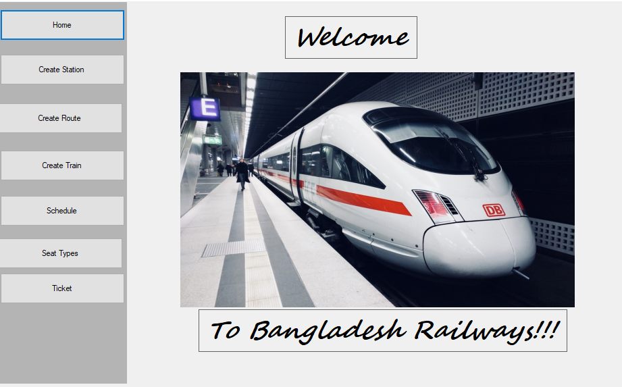
Homepage
This is our home page
Here we can see different buttons.
Each button has different functionalities
In this project we will see the two section of work.one is for authority and the other is for the user.
This page hold the basic information of this project.

Slide 4
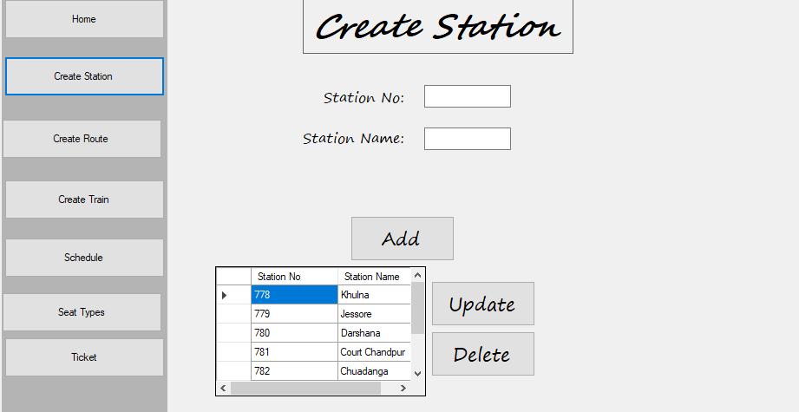
Create station
This section will manage by authority and the worker of railway management.
By using station no and station name they can create a new station
They can also update and delete their stations by using this delete and update button
This is not the user interface.
In this way it will help to under stand that a train will go from on platform to another on

Slide 5
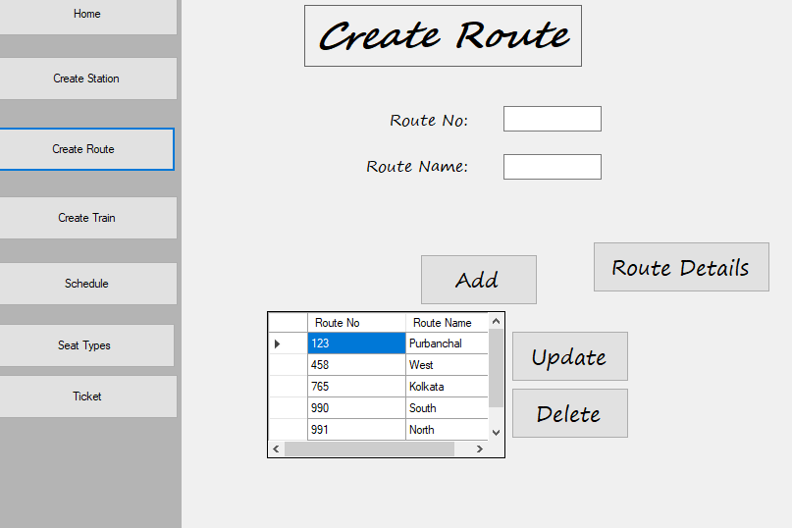
Create route
It will be manage by railway authority.
It is the way by which we under stand that what is the route and what are the station under this route.
This think also create , update and delete by authority
There is an another option that is route details. That help to about the route of the railway management.

Slide 6
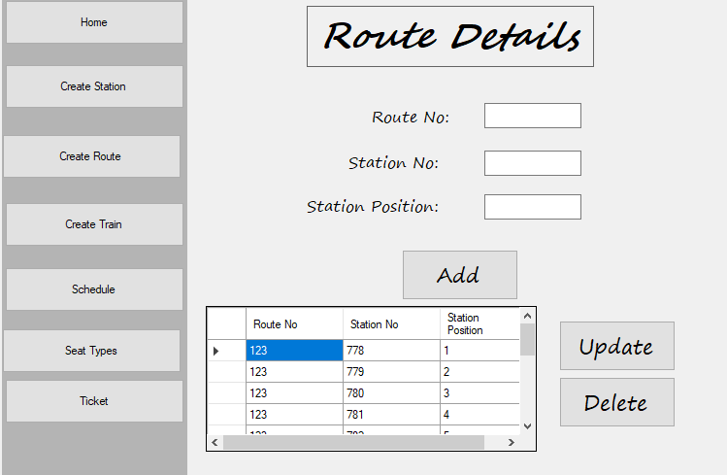
Route Details
Route details is kind to create a new route
To add , delete and update the route authority can easily manage all this.
This add and deletion can only manage by authority and admin
Norman user can not see or manage all this think.

Slide 7
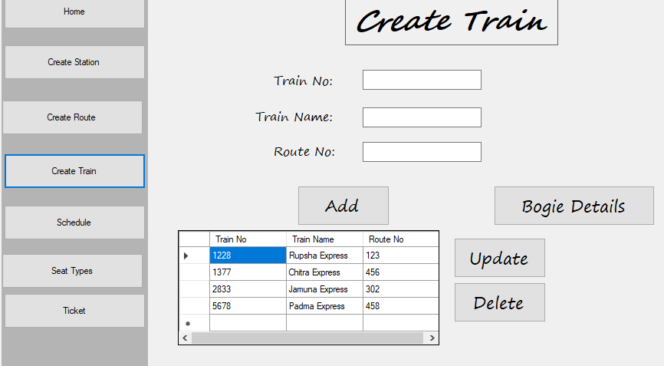
Create Train
To create a train we have to insert train no , train name , route no.
To fill all this information admin can create a new train and that will hold a new route
Under this train there are many bogies that will hold many information.
It is also add and delete by admin.

Slide 8
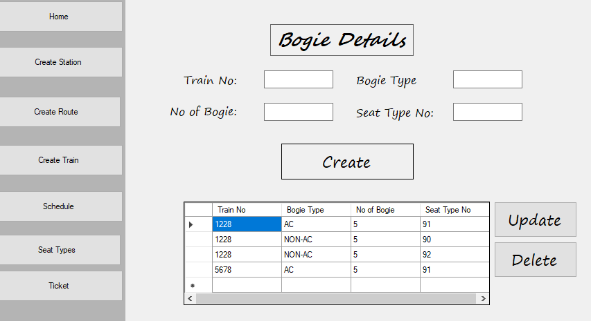
Bogie Details
In a train there are many bogies
Each bogie has different types of
Seat and seat details
Each bogie hold a number that will will help to find out the expected bogie easily
Passenger will easily move from one bogie to another.
This is also a admin interface.

Slide 9
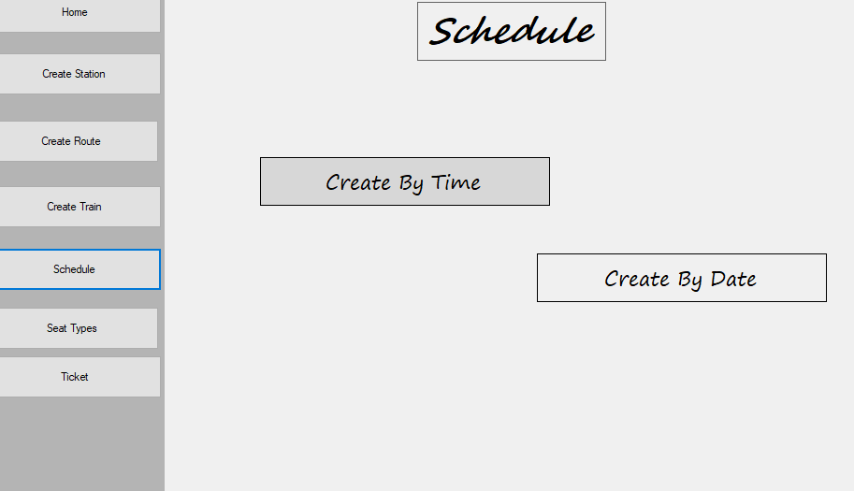
Schedule
Schedule is created by two way
Created by time that is actually
when a train come , when a train
Train go that things are created by
.
Created by date is an another one that is hold the date of a train .

Slide 10
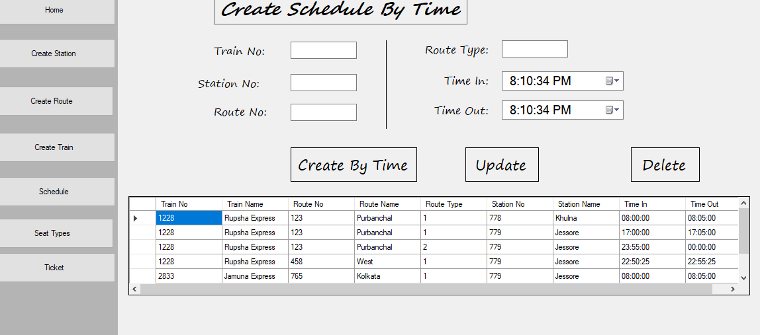
Create schedule by time
A train is maintain by two thing one is date and the another one is time
Admin can crate a train time by create time and they also update or delete the previous schedule
There using time in and time out .
In this thing train come and go and maintain a proper time schedule
This way people can easily know the time and go of the train.
Station will not be crowded.

Slide 11
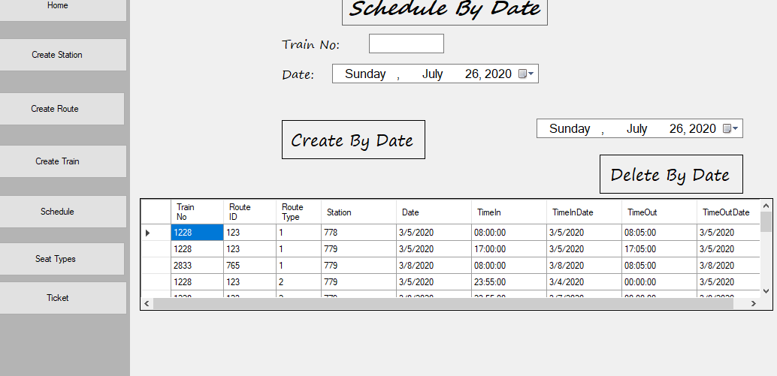
Schedule by date
It is also an another part of schedule
Time and date are the main part of this schedule.
If a train come 11:55pm and left after 5mint then the date will automatically change.
This is an automated that change the date .
So people can be careful to the timing of train.

Slide 12
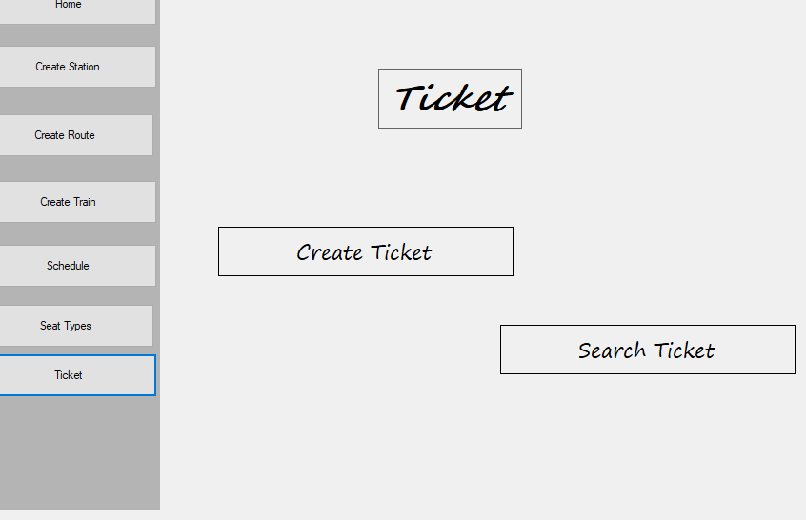
Ticket
It is an user interface and also admin interface .
It divided by two way
Create ticket and search ticket

Slide 13
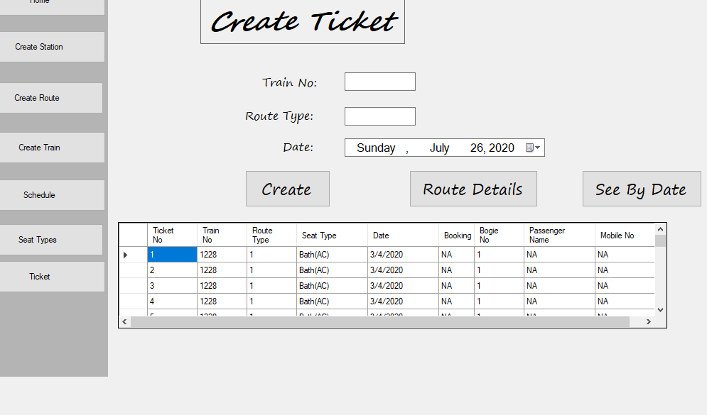
Create Ticket
To create a ticket we have to put train no , route type and data
Here we can go route details to know if we need any information
We can also see the date of train to create a proper ticket.

Slide 14
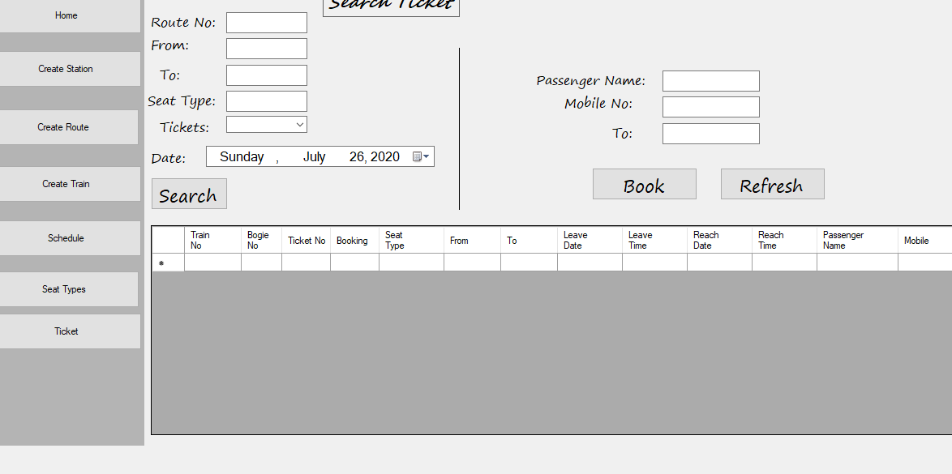
Search Ticket
it is an user interface
People can search ticket and book ticket
To search ticket they have to fill all the information that need in this search option.
For booking they have to put name number ,from where to where
The number of seat they want to book
There is also a refresh button that help to refresh the ticket box …

